Slide 1

CHILD TRACKER WITH EMERGENCY NOTIFIER

Slide 2

Problem Statement
To solve the problem of difficulty in keeping a check on children while they are playing in open areas while letting the children have their freedom from constantly being mocked by parents and to monitor the whereabouts of children by working parents.

Slide 3

HARDWARE COMPONENTS
Arduino UNO
GPS Module
GSM/GPRS Module

Slide 4
Software's
Arduino IDE
Android (MIT app Inventor)

Slide 5
Block Diagram
GPS module
Mobile
App
Arduino
UNO
Cloud
GSM/GPRS module

Slide 6
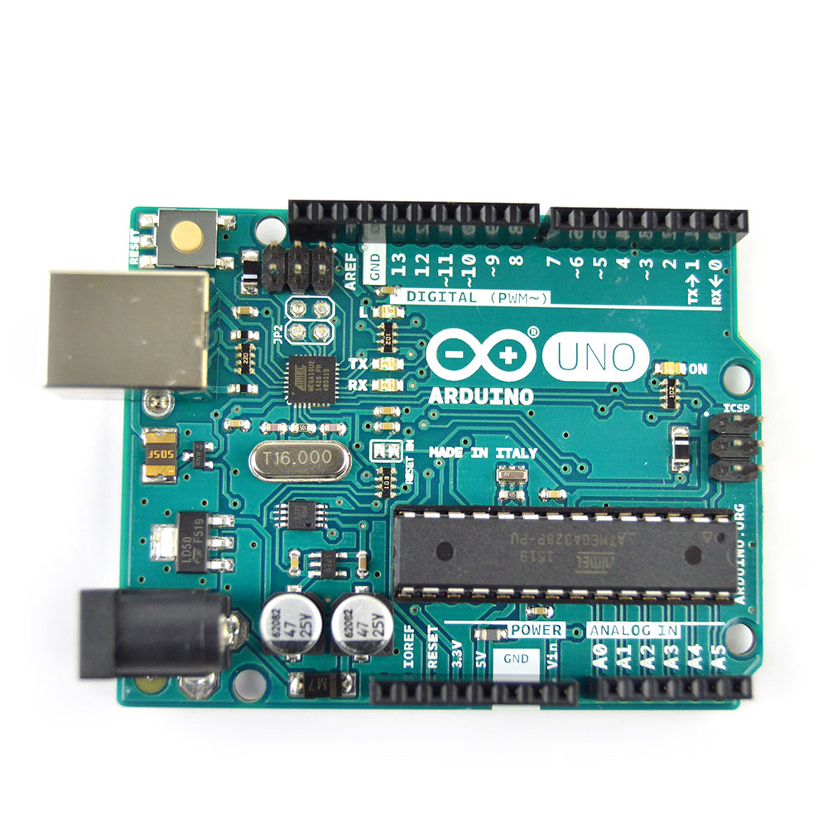
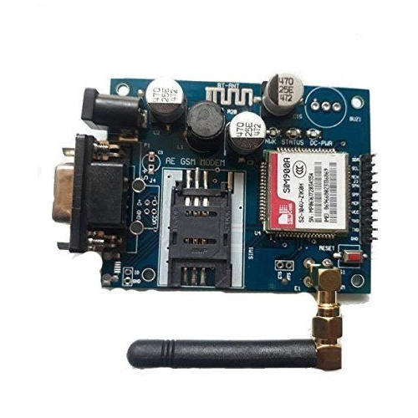
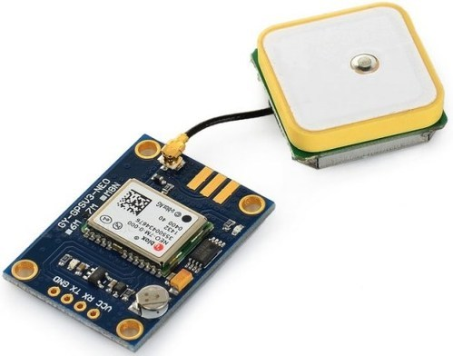
Arduino UNO,GPRS and GPS modules

Slide 7
Arduino UNO
GSM/GPRS Module
GPS Module
It is a microcontroller board
Consists of USB interface, 14 digital I/O pins, 6 analog pins, and Atmega328 microcontroller
Also supports serial communication using Tx and Rx pins.
Global Positioning System
GPS satellites broadcast beams in two carrier frequencies.
The GPS receiver gets a signal from each GPS satellite.
The satellites transmit the exact time the signals are sent.
So given the travel time of the GPS signals from three satellites and their exact position in the sky.
The GPS receiver can determine your position in three dimensions - east, north and altitude.
General Packet Radio Service
It is a packet oriented mobile data service on the 2G and 3G cellular communication system’s
GPRS module is a chip or circuit that will be used to establish communication between a mobile device or a computing machine

Slide 8
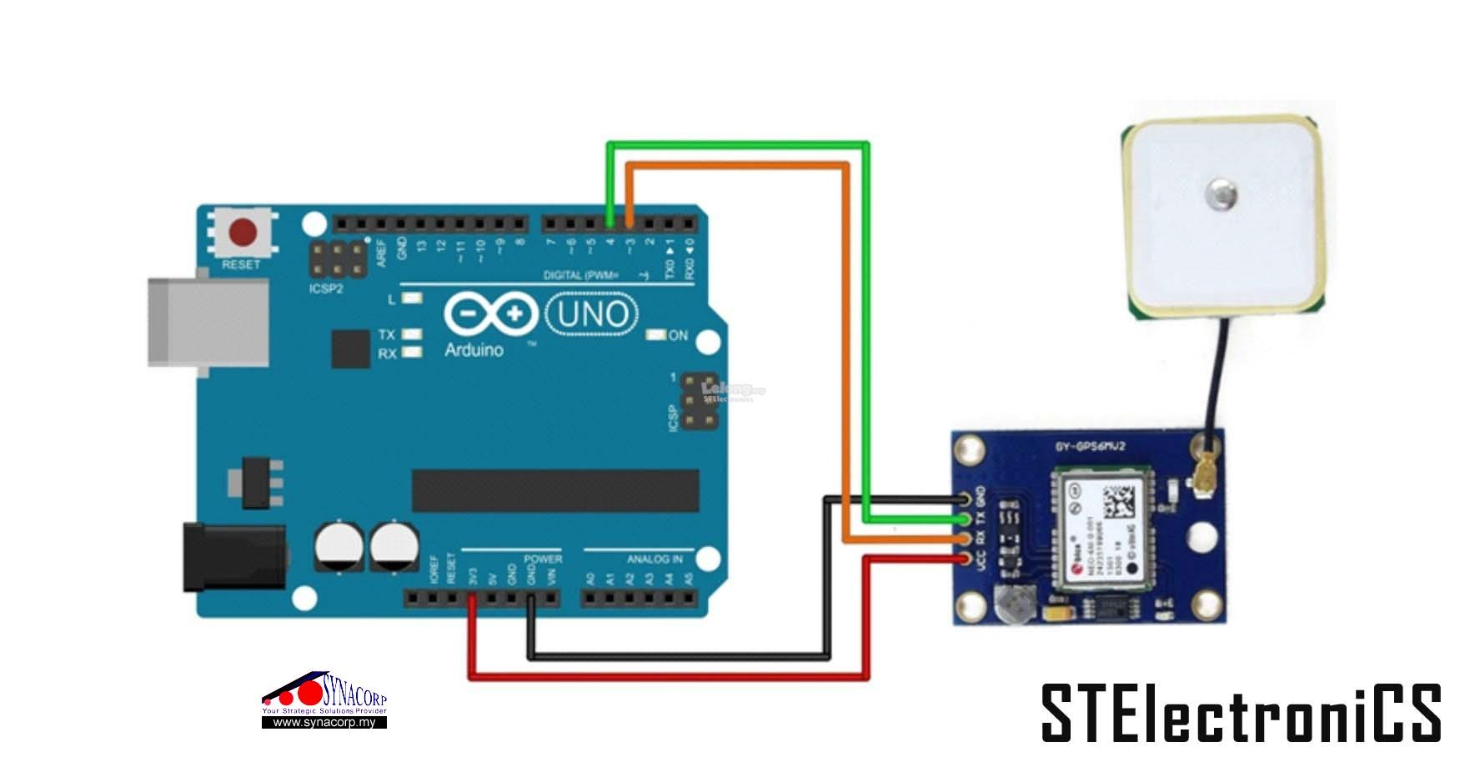
Connections between GPS and Arduino UNO
Connect Vcc of GPS to 3v3 of Arduino UNO.
Connect GND of GPS to
GND of Arduino UNO
Connect RX of GPS to 3 pin on Arduino UNO.
Connect TX of GPS to 4 pin on Arduino UNO.

Slide 9
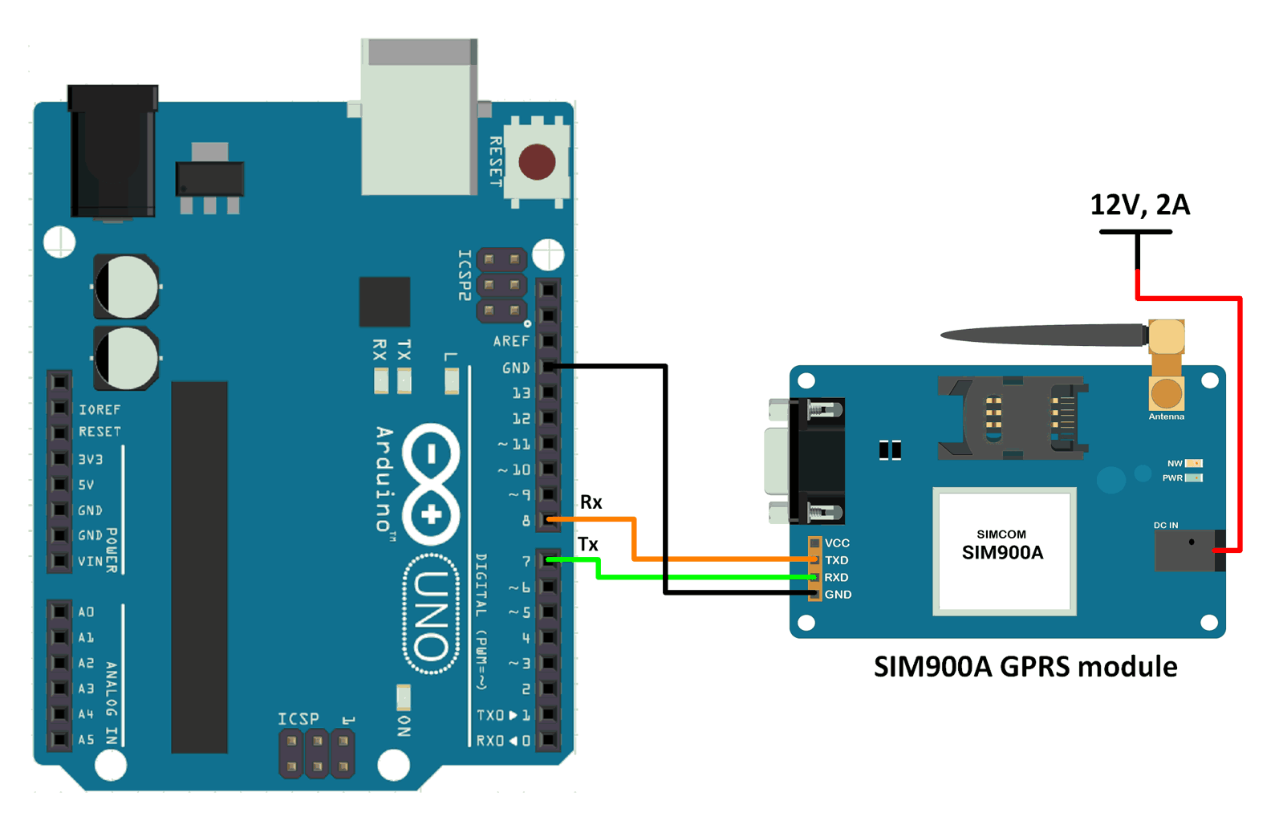
Connections between GPRS and Arduino UNO
Connect GPRS to a 12V power supply.
GND to GND
RX of GPRS to pin 7 (TX) of Arduino UNO
TX of GPRS to pin 7 (RX) of Arduino UNO

Slide 10
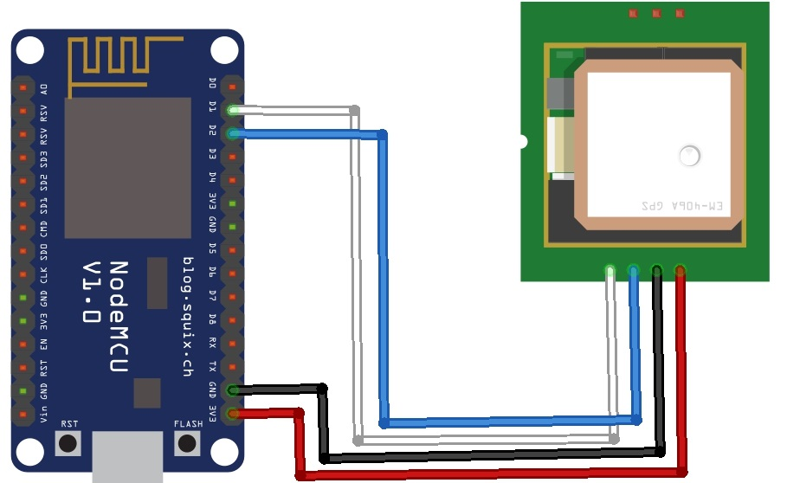
Connection between Node MCU and GPS module
Connect Vcc of GPS to 3v3 of Node MCU
GND to GND
Connect RX of GPS to D2 pin on Node MCU
Connect TX of GPS to D1 pin on Node MCU.

Slide 11
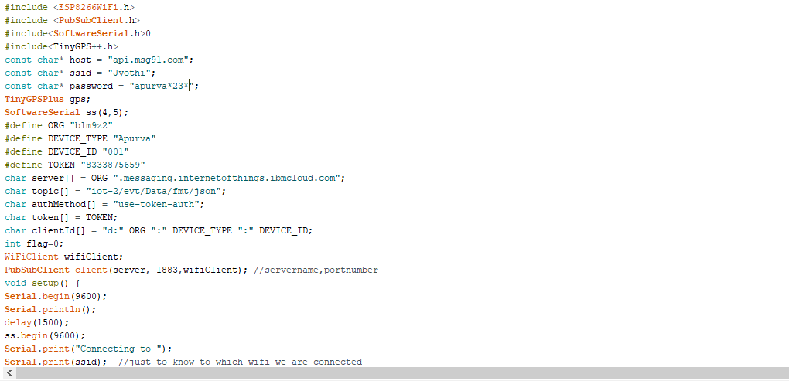
ARDUINO CODE:

Slide 12
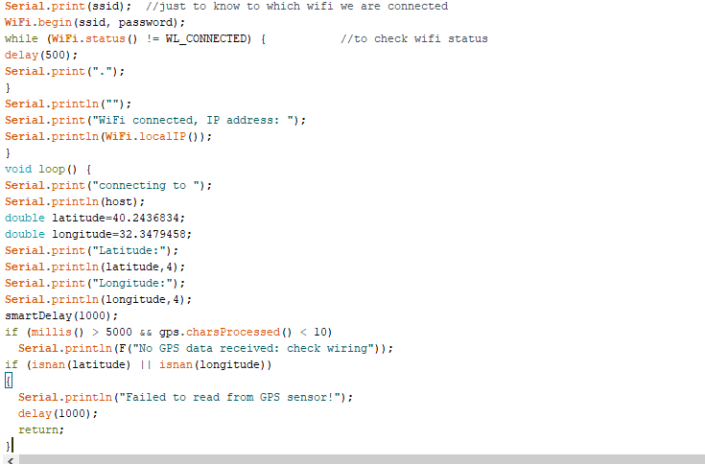

Slide 13
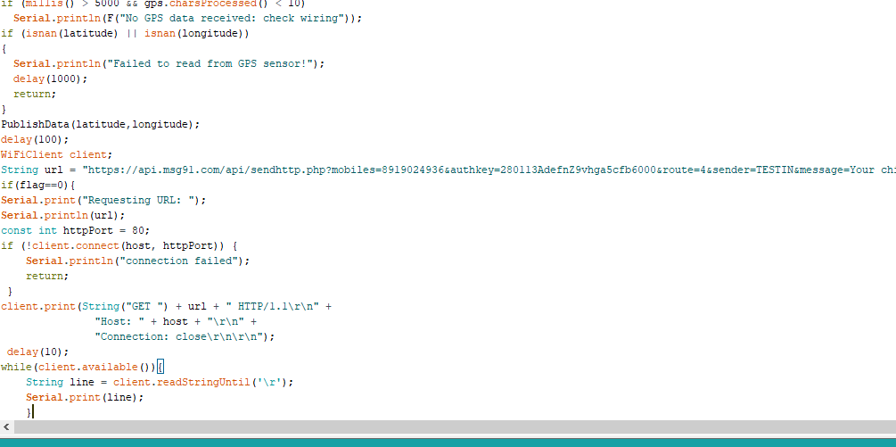

Slide 14
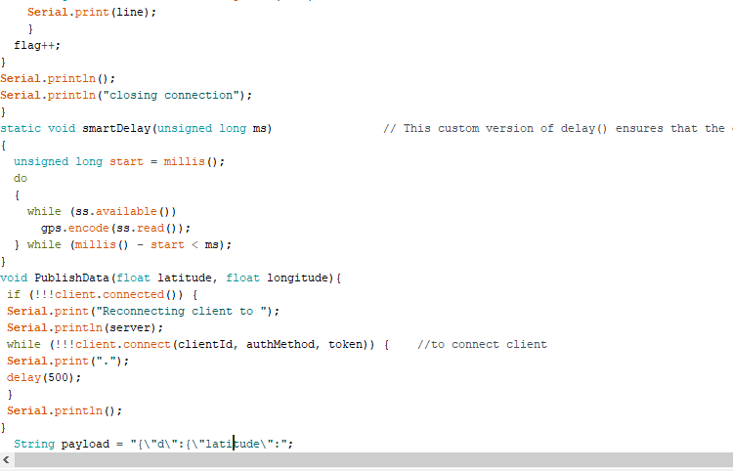

Slide 15
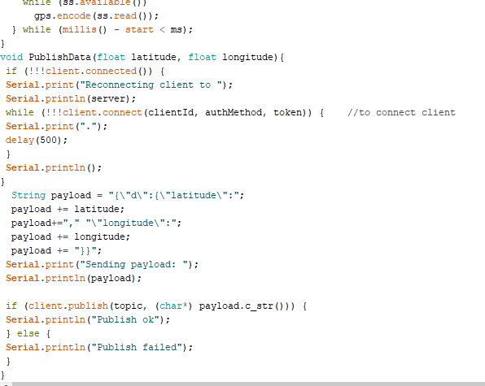

Slide 16
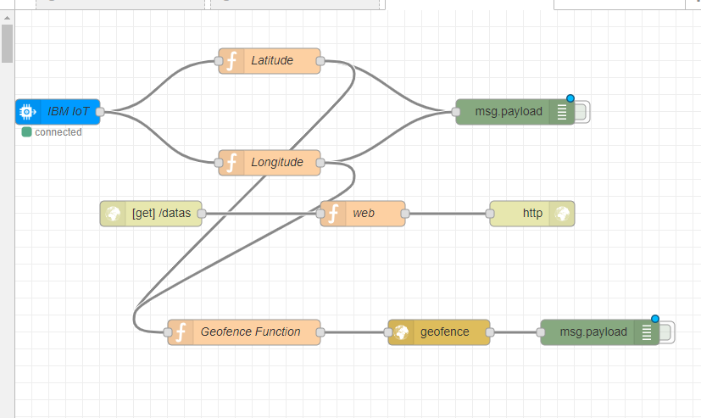
NODE RED FLOW:

Slide 17
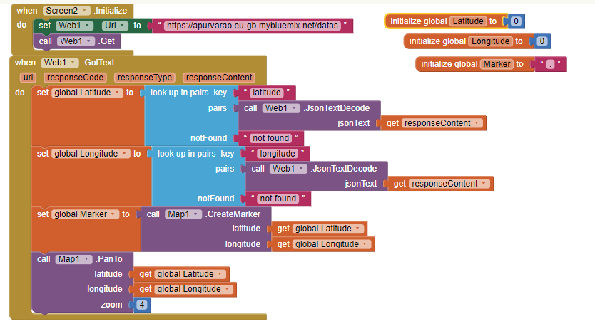
MIT CODE:

Slide 18
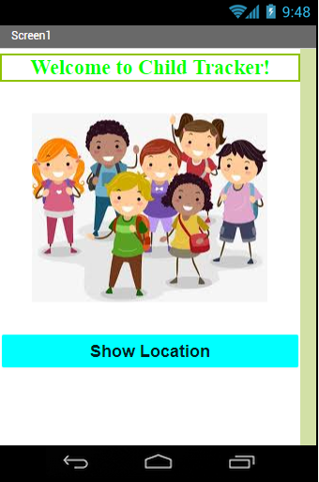
MIT App inventor
SCREEN 1
Contains a Label
Button to screen 2

Slide 19
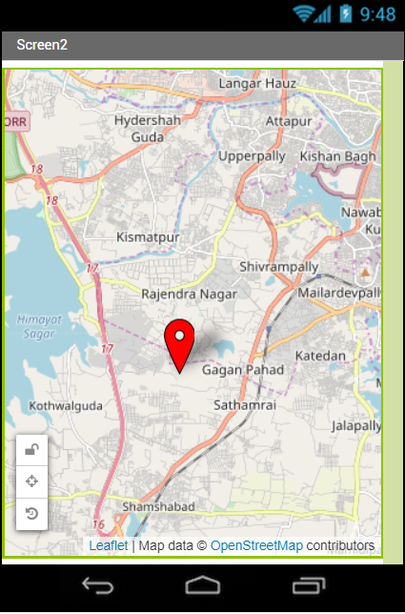
Screen 2

Slide 20
Advantages
Keeps track of children in case of abduction
Allows children more freedom while being watched
Monitors children with special needs who wander
Helps monitor children with behavioral problems
Gives peace of mind to parents

Slide 21

Thank You -D. APURVA, C.VIDULA, A.BHAVANA

